Slide 1
CMIS 3122 Rapid Application Development
supervised by:
Mr. T. Arudchelvam
Presented by:
Group No : 07
192058 - H. D. N. Kavindi
192149 - R. J. Wijayasundara

Slide 2




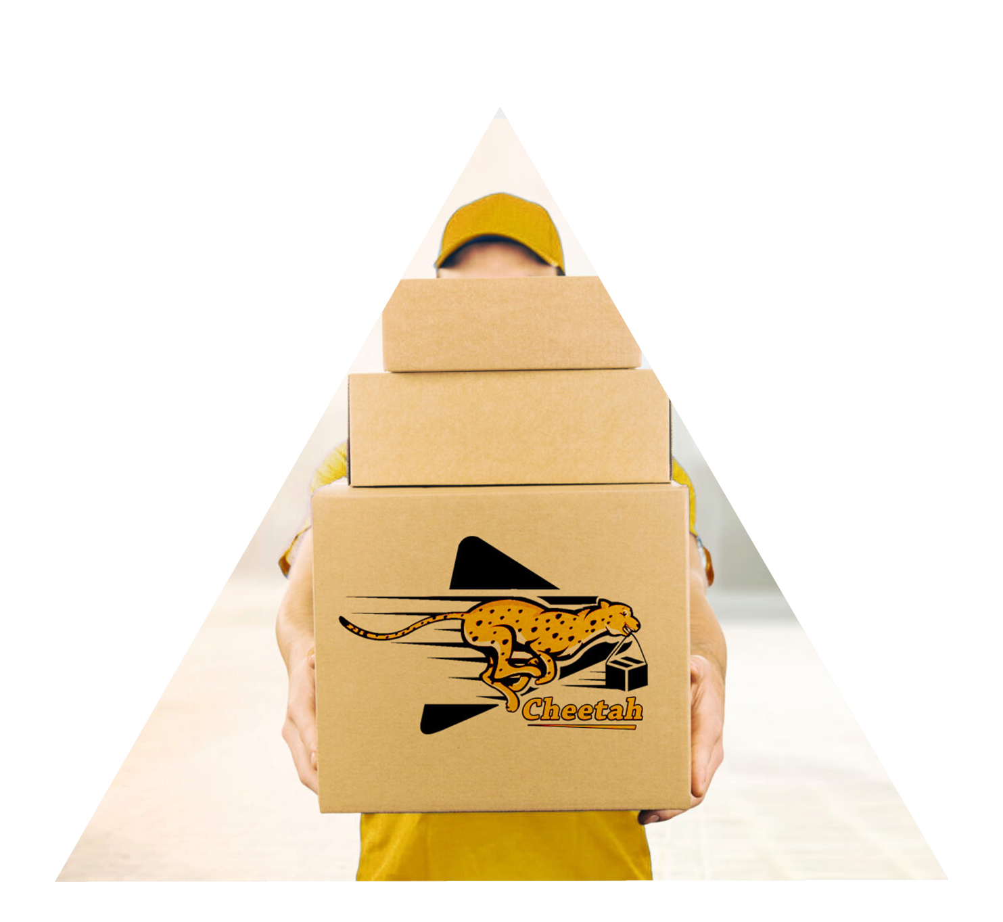
Cheetah Delivery Service
1

Slide 3

Introduction
This is a website where people can easily deliver their parcel by making a request for the delivery service that will come and collect the parcel at a convenient time for the user and easily find out how the parcel is going and whether the parcel is delivered.
2

Slide 4

Our Client
Mr. U. B. U. Nisala
Manager – Cheetah Delivery Service
3

Slide 5
Why We Design This System
People have to go by themselves and give their parcels to receiver.
It is more time consuming.
people can send a request for the delivery service that will come and collect the parcel at a convenient time for the sender
find out how the parcel is going and whether the parcel is delivered
4

Slide 6
Innovations
People can send a request for the delivery service to collect their parcels.
People can find status whether the parcel delivered or not.
5

Slide 7

Advantages for User
Easy for people to send their parcels by staying at home.
People can send a request for the delivery service to collect their parcels.
People can save their time and money.
Can be found status whether the parcel delivered or not.
Can be accessed given parcel details by system.
6

Slide 8
Advantages for Administration
Reduce the inconvenient delay.
Reduce the human errors.
Increase the employees’ privacy.
Protect from the natural disasters.
7

Slide 9

System Involves
Administrator:
Has Administrative access to control all the users, user details, parcel details, parcel status.
Users:
Users can requesting to deliver, access parcel details and find status whether parcel delivered
8

Slide 10







Technology And Tools
Programming Language
Database
Text Editor
External Tools
9

Slide 11
Product backlog
Task ID | Backlog Story | Priority
1 | As a user, I want to add a user details to the system to create new account. | 1
3 | As an administrator or user, I want to login to the system successfully. | 2
5 | As a user, I want to add, search and remove parcel details to the system. | 3
6 | As an administrator, I want to add, search, remove, update and manage the parcel details | 4
7 | As an administrator, I want update and manage the parcel result whether delivered, pending or return. | 5
2 | As an administrator, I want to create new user accounts, administrator accounts, remove accounts and view all account and manage them. | 6
8 | As an administrator or user, I want to view all added parcel details | 7
4 | As an administrator, I want to access and manage users’ details. | 8
9 | As an user I want to request to pickup parcels. | 9
10

Slide 12
Demonstration
11

Slide 13

Issues We Faced
Had to deal with some uploading errors of the GitHub while using git push.
We intent to use Laravel as a framework to create backend of website but we understood pure php is easy than the Laravel.
In designing of the interface have been occurred problems of margin of web pages
The XAMPP server was suddenly broke down and the database was crashed.
Errors occurred in some button functions
12

Slide 14

Conclusion
By using this system user can send a request for the delivery service to collect their parcels.
Can find status whether the parcel delivered or not
The company owner can easily manage all.
13

Slide 15

Thank you !

